Slide 1
Functions, Loops & Nested Loops
By Tooba Ahmed Alvi

Slide 2
Recap from last lecture…..
Defining & Using Variables
Type conversion and Type casting importance
Logical Operations and Conditionals
Basic Arithmetic Operations
Concept of Input and output in computer programming
Defining Functions in Python

Slide 3
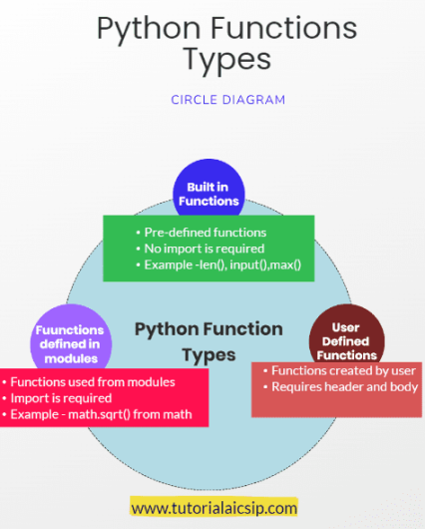
FUNCTIONS IN PYTHON

Slide 4
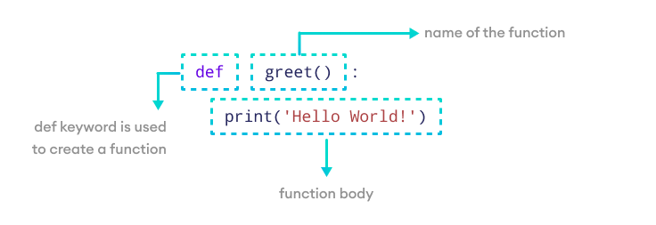
FUNCTIONS - SYNTAX

Slide 5
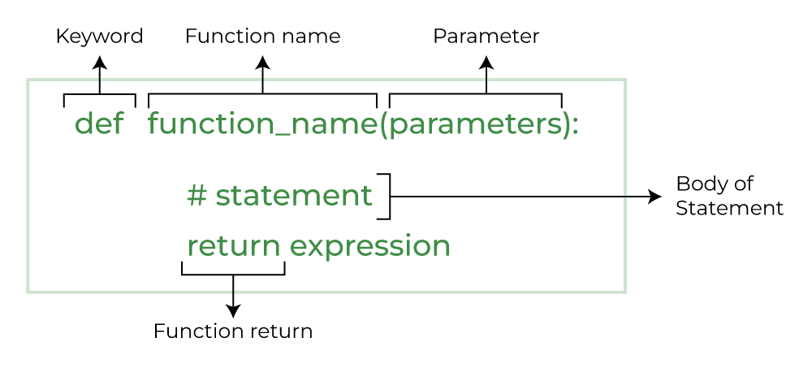
FUNCTIONS -SYNTAX

Slide 6
FUNCTIONS - EXAMPLE #1
#Defining a function
def my_function():
print("Hello from a function")
#Calling a function
my_function()

Slide 7
FUNCTIONS - EXAMPLE #2 and #3
def greet(name):
print("Hello", name)
# pass argument
greet("John")
# function with two arguments
def add_numbers(num1, num2):
sum = num1 + num2
print("Sum: ", sum)
# function call with two values
add_numbers(5, 4)

Slide 8
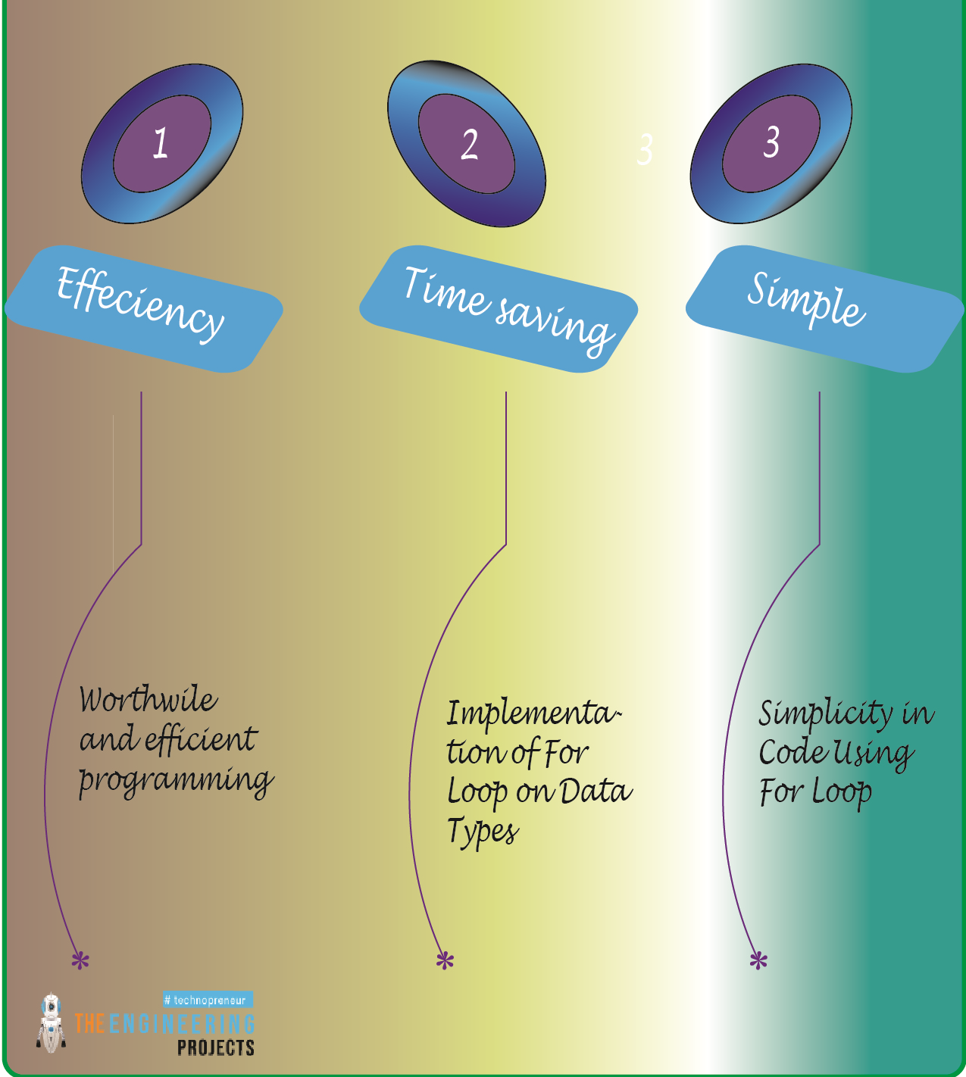
LOOPS & NESTED LOOPS IN PYTHON

Slide 9
WHY LOOP IS NECESSARY IN CODING?
Try counting to ten in your head. Pretty easy, right? You likely had no trouble reciting those ten words "One, Two, Three..." from memory. Now, what if you had to teach somebody to count? First, you say "One," then you say "Two," then you say "Three" all the way until you say "Ten," and then you stop.
It turns out that if we want our computer to count for us, we will have to teach it how using a loop!
Types of Looping :
For Loop
While Loop

Slide 10
FOR LOOP
A for-loop has three parts:
Loop Variable (i) - the variable that changes after each iteration of the loop
Range (n)- Which values the loop variable takes on in each iteration
Code Body - the block of code that gets repeated at each iteration
The most basic for-loop is one that loops for all values from 0 to some number. This is how we get our computer to count to a certain number. We use the range function to specify which number that is:

Slide 11
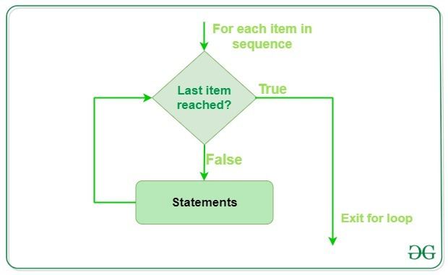
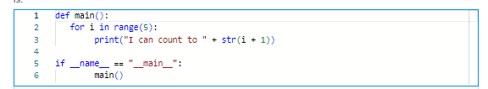
FOR LOOP EXAMPLE #1:

Slide 12
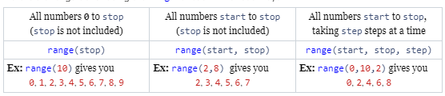
FOR LOOP SYNTAX EXAMPLES
Use the range function to set the number of times you want your code to loop. range is more powerful than this, though. What range does is present the for-loop with all the values that i should take on, and the for-loop just repeats once for each of those values. When we say
for i in range(some number):
we really mean “repeat the following code one time for each value from 0 to some number”.

Slide 13
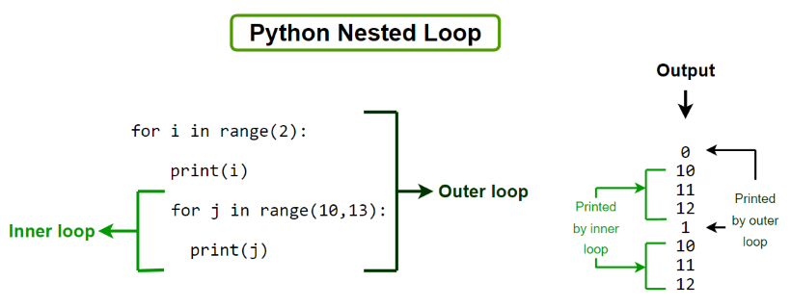
NESTED FOR LOOP EXAMPLE #1

Slide 14
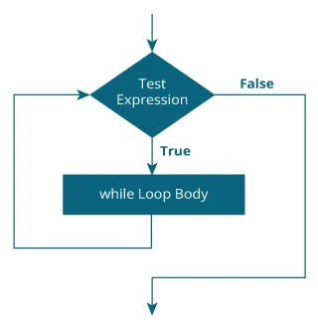
WHILE LOOP
The while loop evaluates the test Expression inside the parentheses ().
If test Expression is true, statements inside the body of while loop are executed. Then, test Expression is evaluated again.
The process goes on until test Expression is evaluated to false.
If test Expression is false, the loop terminates (ends).

Slide 15
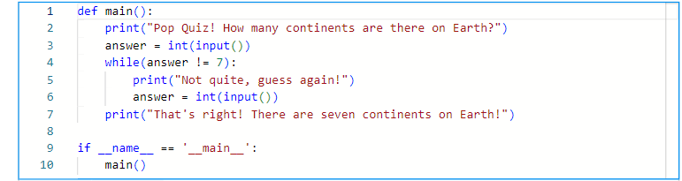
WHILE LOOP _EXAMPLE

Slide 16
Questions?
What questions do you have before we begin coding the problem?

Slide 17
Let’s Code!
For this activity, we’ll break out again, and then come back together!

Slide 18
HOMEWORK -DEADLINE NEXT FRIDAY
Write a function that will take 3 arguments as input to check whether a number falls within a given range(start and end values).
def check_num(number,start,end):
Write a Python function that takes a number as a parameter and checks whether the number is prime or not. (By using for loop)
Note: A prime number (or a prime) is a natural number greater than 1 and that has no positive divisors other than 1 and itself.
ASSIGNMENT SUBMISSION FORM:
https://forms.gle/NfcqhruYwrSt9BFf7

